Slide 1

NHibernate Fundamentals
2 – Basic Mapping and Persistence

Slide 2
Overview
Concepts
Data types
Gotchas
Components
Key generation

Slide 3
Concepts
Class Definition
Metadata Mapping
Database Schema

Slide 4
Mapping Metadata
XML-based | *.hbm.xml files | Likely the most common way
Code-based | ClassMap<T> in Fluent NHibernate (http://fluentnhibernate.org) | My favorite and has great use with IoC / DI
Convention-based | Loquacious FluentNHibernate | Easy, and works great as code first

Slide 5
Mapping Data Types
int, double, decimal
String
Bool
DateTime
Enum
Complex objects
Collections

Slide 6
*.hbm.xml elements
class
id
discriminator
generator
natural-id
property
not-null
name
mutable
version
subclass
extends
list
cascade
one-to-many
index

Slide 7
*.hbm.xml
We are not going to use them in our examples

Slide 8
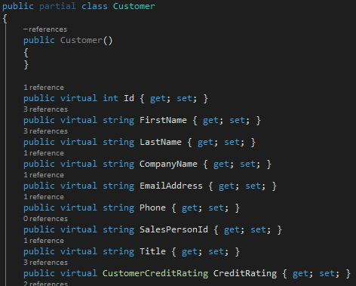

Enumerations
Pro-tip… Always map to strings
I’ve seen demos where this needs a mapping class using xml maps. I’ve not seen this with the fluent API.

Slide 9
Components
Components are value objects
Have no primary keys
Persisted in same table as the owner

Slide 10
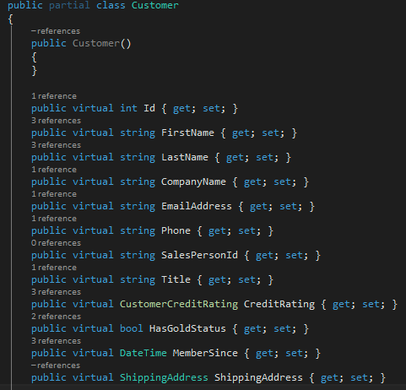
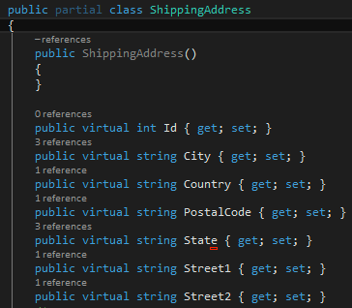
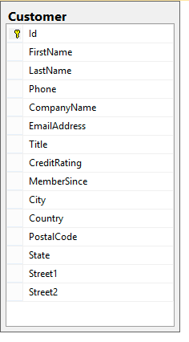
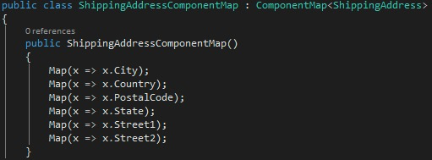

Slide 11
Demo: Enumerations and Components

Slide 12
Mapping Gotcha’s
DateTime.Min
Database min may not be the same as .NET
DateTime.Kind
Database may not store UTC / local time zone
Floating point numbers
String truncation

Slide 13
Examples and ID’s
All the examples will use identity id’s

Slide 14
Primary Key Generation
Assigned
Applications Responsibility to assign the PK
Native
Use identity, Sequence or Hilo depending on the database engine
Identity
Use identity column in supported databases

Slide 15
Primary Key Generation Techniques
Assigned | Applications responsibility to assign a PK
Native | Use Identity, Sequence or HiLo depending on the database
Identity | Use identity column in supported databases
Sequence | Use sequence in supported databases
HiLo | Use HiLo algorithm with a table (hilo) or sequence (seqhilo)
Guid or Guid.Comb | Use a GUID

Slide 16
Identifier type categories
Non-insert
Post-insert

Slide 17
Non-Insert ID Generators
hilo | Uses hi-lo algorithm managed in database table
guid | Uses System.Guid.NewGuid()
guid.comb | Seemingly random, but using current data /time
guid.native | Used GUID from the database
uuid.hex | Human readable string of 32 characters
uuid.string | Non-human readable
counter | Simple counter based on clock. Not for shared-databases
increment | Uses max primary key from db. Not for shared-databases
sequence | New ID from DB. Round trip required.
seqhilo | Combines hi-lo with a seq generator for better performance
foreign | Uses keys across a 1:1 relationship

Slide 18
Post-insert ID Generators
identity | Database generated
select | Does a SELECT to fetch the row ID after insert
sequence-identity | Database generated from named sequence
trigger-identity | ID generated from a trigger

Slide 19
Recommendations
Do not use “assigned”
Nhibernate cannot tell if the object is new or updated
Avoid “identity” or “sequence”
Nhibernate must make a database roundtrip per new object
Avoid “native”
For most databases, this maps to identity or sequence
Don’t like GUIDs? Use hilo or seqhilo
Nhibernate can make a single call to the database to reserve a range of PKs
PKs only unique to a single database
Ok with GUIDs? Use guid.comb
Nhibernate can assign PKs without calling the database
PKs are unique across a cluster
Guid.comb algorithm avoids index fragmentation issues

Slide 20
Summary
ID’s have ramifications based upon the database and type of ID
Enums should be mapped to strings
Components map into columns on owners
Use the appropriate key generations strategy

